Slide 1
Using Logic Programming to Recover C++ Classes and Methods from Compiled Executables
Edward J. Schwartz, Cory F. Cohen, Michael Duggan, Jeffrey Gennari, Jeffrey S. Havrilla, Charles Hines

Slide 2
Copyright 2018 Carnegie Mellon University. All Rights Reserved.
This material is based upon work funded and supported by the Department of Defense under Contract No. FA8702-15-D-0002 with Carnegie Mellon University for the operation of the Software Engineering Institute, a federally funded research and development center.
The view, opinions, and/or findings contained in this material are those of the author(s) and should not be construed as an official Government position, policy, or decision, unless designated by other documentation.
NO WARRANTY. THIS CARNEGIE MELLON UNIVERSITY AND SOFTWARE ENGINEERING INSTITUTE MATERIAL IS FURNISHED ON AN "AS-IS" BASIS. CARNEGIE MELLON UNIVERSITY MAKES NO WARRANTIES OF ANY KIND, EITHER EXPRESSED OR IMPLIED, AS TO ANY MATTER INCLUDING, BUT NOT LIMITED TO, WARRANTY OF FITNESS FOR PURPOSE OR MERCHANTABILITY, EXCLUSIVITY, OR RESULTS OBTAINED FROM USE OF THE MATERIAL. CARNEGIE MELLON UNIVERSITY DOES NOT MAKE ANY WARRANTY OF ANY KIND WITH RESPECT TO FREEDOM FROM PATENT, TRADEMARK, OR COPYRIGHT INFRINGEMENT.
[DISTRIBUTION STATEMENT A] This material has been approved for public release and unlimited distribution. Please see Copyright notice for non-US Government use and distribution.
This material may be reproduced in its entirety, without modification, and freely distributed in written or electronic form without requesting formal permission. Permission is required for any other use. Requests for permission should be directed to the Software Engineering Institute at permission@sei.cmu.edu.
DM18-0828

Slide 3
Goal
C++ Abstractions
Shape
Inherits From
Square
C++
Binary
SquareHelper
Is Composed Of

Slide 4
Goal
C++ Abstractions
Shape
virtual draw()
virtual getArea()
print()
Inherits From
Square
virtual draw()
virtual getArea()
getLength()
C++
Binary
SquareHelper
areaLogic()
Is Composed Of

Slide 5
Goal
C++ Abstractions
Shape
virtual draw()
virtual getArea()
print()
int cached_area
Inherits From
Square
virtual draw()
virtual getArea()
getLength()
int side_len
SquareHelper sqh
C++
Binary
SquareHelper
areaLogic()
Is Composed Of

Slide 6
Goals: How?
Static
Analyze program without executing it
Can be applied to unknown software
No need for test cases
Recover all classes and all methods
Do not rely on RTTI metadata
Only available for polymorphic classes
Often removed or corrupted in malware

Slide 7
Existing Work
System | Static | All classes | All methods | Works w/o RTTI
SmartDec Fokin 2010 | ✔ | ✘ | ✔ | ✔
SecondWrite Yoo 2014 | ✔ | ✘ | ✘ | ✘
Various CFI systems Pawlowski 2017, etc. | ✔ | ✘ | ✘ | ✔
These systems primarily recover information from virtual function tables

Slide 8
Virtual Function Tables
Shape's VFTable
0: Shape::draw
1: Shape::getArea
Square's VFTable
0: Square::draw
1: Square::getArea
VFTables enumerate the virtual functions of each class… but only for polymorphic classes.

Slide 9
Existing Work
System | Static | All classes | All methods | Works w/o RTTI
SmartDec Fokin 2010 | ✔ | ✘ | ✔ | ✔
SecondWrite Yoo 2014 | ✔ | ✘ | ✘ | ✘
Various CFI systems Pawlowski 2017, etc. | ✔ | ✘ | ✘ | ✔
Lego Srinivasan 2014 | ✘ | ✔ | ✔ | ✔
ObjDigger Jin 2014 | ✔ | ✔ | ✔ | ✔

Slide 10
ObjDigger
ObjDigger uses object pointer tracking to recover non-polymorphic classes too
void foobar () {
Obj *x = new Obj();
x->foo ();
func1(x);
}
void func1 (Obj* o) {
o->bar ();
}
foo is either defined on Obj class or inherited
bar is either defined on Obj class or inherited
If the Obj class does not inherit, it defines foo and bar

Slide 11
Ambiguous Scenarios
Square
draw()
Square
Square
int main() {
Square sq;
sq.draw ();
}
Inherits From
Inherits From
Shape
Shape
draw()

Slide 12
ObjDigger's Shortcomings
ObjDigger makes mistakes on ambiguous scenarios
We tuned it so it was "usually" correct
But mistakes propagated and caused more serious problems
ObjDigger was written procedurally in C++
if (ambiguous_scenario) { classes[foo].add_method(bar); } // guess!
There was no mechanism to detect mistakes and repair them
Improving accuracy became more and more difficult

Slide 13
OOAnalyzer
OOAnalyzer was designed to overcome ObjDigger's shortcomings
Reasoning implemented in Prolog
Hypothetical reasoning
Detect ambiguous scenarios, and make best guess first
New: detect when guesses introduce inconsistency and undo them
Implemented using Prolog backtracking
Reasoning is defined using declarative rules
Much easier to understand and maintain

Slide 14
OOAnalyzer System Design

Slide 15
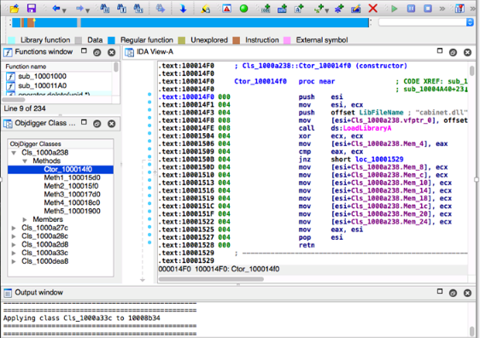
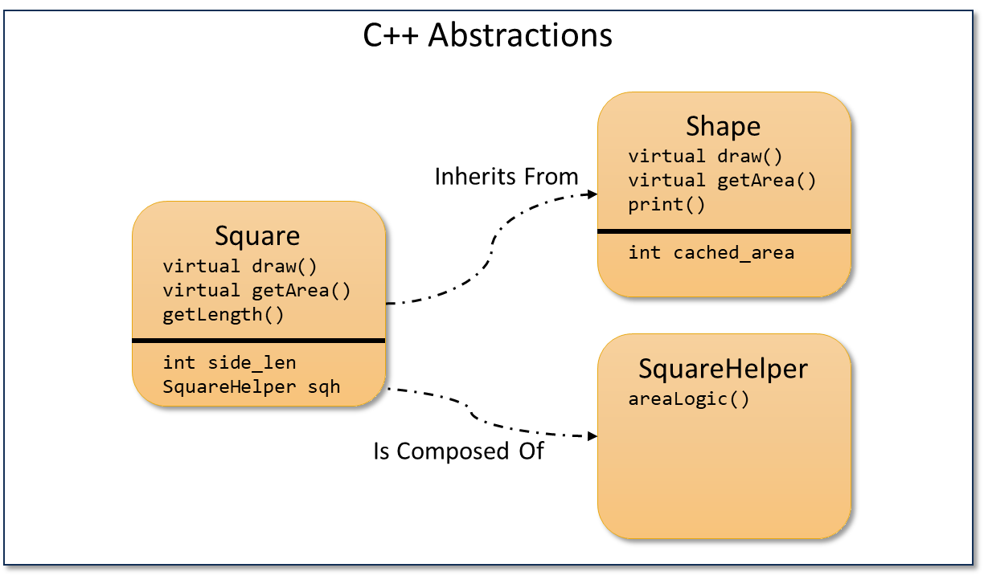
C++
Binary
Pharos Framework
Fact Exporter
Prolog Reasoning
Forward Reasoning
Hypothetical Reasoning
Consistency Checking

Slide 16
Fact Exporter
Uses conventional binary analysis to produce initial facts about the program
Initial facts describe low-level program behaviors
Simple symbolic analysis
Intentionally favors scalability over accuracy
Does not use constraint solvers
Symbolic memory aliases if memory addresses are equal after simplification
Path sensitive up to a threshold
Sufficient because reasoning system can cope with mistakes

Slide 17
Initial Facts
Initial facts describe low-level program behaviors and form the basis upon which OOAnalyzer's reasoning system operates
Initial facts describe low-level program behaviors
Fact Name | Description
ObjPtrAllocation(I, F, P, S) | Instruction I in function F allocates S bytes of memory for the object pointed to by P.
ObjPtrInvoke(I, F, P, M) | Instruction I in function F calls method M on the object pointed to by P.
ObjPtrOffset(P₁, O, P₂) | Object pointer P₂ points to P₁ + O.
MemberAccess(I, M, O, S) | Instruction I in method M accesses S bytes of memory at offset O from the current object's pointer.
ThisCallMethod(M, P) | Method M receives the object pointed to by P in the ecx register.
NoCallsBefore(M) | No methods are called on any object pointer before method M.
ReturnsSelf(M) | Method M returns the object pointer that was passed as a parameter.
UninitializedReads(M) | Method M reads memory that was not written to by M.
PossibleVFTableEntry(VFT, O, M) | Method M may be at offset O in vftable VFT.

Slide 18
Entity Facts
Entity facts are produced during the reasoning process and describe the high-level model of the program being analyzed
Initial facts describe low-level program behaviors
Fact Name | Description
Method(M) | Method M is an OO method on a class or struct.
Constructor(M) | Method M is an object constructor.
Destructor(M) | Method M is an object destructor.
Cl_{a} $=$ Cl_{b} | The sets of methods Cl_{a} and Cl_{b} both represent methods from the same class. These sets should be combined into a single class.
Cl_{a} ≤ Cl_{b} | The sets of methods Cl_{a} and Cl_{b} either both represent methods from the same class, or, the methods in Cl_{b} are inherited from Cl_{a}.
M $∈$ Cl | Method M is defined directly on class Cl.
ClassCallsMethod(Cl, M) | An instance of class Cl calls method M.
Other categories include virtual functions, class relationships, and sizes of classes and tables.

Slide 19
Reasoning
Forward reasoning
Unambiguous scenarios
Interpretation: If $P1$, $P2$, … and $Pn$ are satisfied, then $C$ is true
If inconsistency is reached, $P1$, $P2$, … or $Pn$ must not be true
Hypothetical reasoning
Ambiguous scenarios
Interpretation: If $P1$, $P2$, … and $Pn$ are satisfied, then guess $C$ is true
If inconsistency is reached, then retract $C$ and assume $¬C$
If inconsistency is still reached, $P1$, $P2$, … or $Pn$ must not be true

Slide 20
Forward Reasoning
If a method is directly called on a base class, it cannot be directly defined on the derived class.

Slide 21
Hypothetical Reasoning
If a method is called on a derived class but not a base class, (first) assume the method is defined on the derived class.

Slide 22
Hypothetical Reasoning
Square
draw()
Square
Inconsistency
draw on Square?
Reasoning
Backtracking
Inherits From
Shape
int main() {
Square sq;
sq.draw ();
}

Slide 23
Hypothetical Reasoning
Square
Square
Inconsistency
draw on Square?
Reasoning
Backtracking
✔
draw on Shape?
Reasoning
Inherits From
Shape
draw()
int main() {
Square sq;
sq.draw ();
}

Slide 24
Research Questions & Evaluation

Slide 25
Research Questions
How well does OOAnalyzer identify C++ classes and their constituent methods?
OOAnalyzer classes may not naturally correspond to ground truth classes
New metric: edit distance

Slide 26
Edit Distance Example
OOAnalyzer
Edit 1
Edit 2
Ground Truth
Class ?
&Class1::A
&Class2::B
Class ?
&Class1::A
Class ?
&Class1::A
&Class1::B
Class 1
&Class1::A
&Class1::B
Class ?
&Class1::B
&Class2::A
Class ?
&Class1::B
&Class2::A
&Class2::B
Class ?
&Class2::A
&Class2::B
Class 2
&Class2::A
&Class2::B
Move
Move

Slide 27
ObjDigger vs OOAnalyzer Edit Distances on ObjDigger Programs
ObjDigger made 121 mistakes
ObjDigger recovered about 45% of methods
OOAnalyzer recovered about 90% of methods
Program | # Class | # Method | ObjDigger Edits | ObjDigger Edits (%) | OOAnalyzer Edits | OOAnalyzer Edits (%)
CImg | 29 | 220 | 121 | 55.0% | 21 | 9.5%
Light-pop3-smtp | 44 | 295 | 134 | 45.4% | 44 | 14.9%
Optionparser | 11 | 56 | 23 | 41.1% | 6 | 10.7%
PicoHttpD | 95 | 656 | 393 | 59.9% | 166 | 25.3%
X3c | 6 | 28 | 6 | 21.4% | 5 | 17.9%

Slide 28
ObjDigger vs OOAnalyzer Edit Distances on Cleanware
Program | # Class | # Method | ObjDigger Edits | ObjDigger Edits (%) | OOAnalyzer Edits | OOAnalyzer Edits (%)
Firefox.exe | 141 | 638 | 507 | 79.5% | 212 | 33.2%
Log4cpp Debug | 139 | 893 | 829 | 92.8% | 239 | 26.8%
Log4cpp Release | 76 | 378 | 272 | 72.0% | 75 | 19.8%
muParser Debug | 180 | 1437 | 1361 | 94.7% | 483 | 33.6%
muParser Release | 94 | 598 | 369 | 61.7% | 183 | 30.6%
MySQL cfg_editor.dll | 190 | 1266 | $$∞$$ | $$∞$$ | 391 | 30.9%
MySQL mysql.exe | 202 | 1395 | $$∞$$ | $$∞$$ | 439 | 31.5%
TinyXML Debug | 35 | 415 | 268 | 64.6% | 69 | 16.6%
TinyXML Release | 33 | 283 | 174 | 61.5% | 55 | 19.4%

Slide 29
ObjDigger vs OOAnalyzer Edit Distances on Cleanware
Program | # Class | # Method | ObjDigger Edits | ObjDigger Edits (%) | OOAnalyzer Edits | OOAnalyzer Edits (%)
Firefox.exe | 141 | 638 | 507 | 79.5% | 212 | 33.2%
Log4cpp Debug | 139 | 893 | 829 | 92.8% | 239 | 26.8%
Log4cpp Release | 76 | 378 | 272 | 72.0% | 75 | 19.8%
muParser Debug | 180 | 1437 | 1361 | 94.7% | 483 | 33.6%
muParser Release | 94 | 598 | 369 | 61.7% | 183 | 30.6%
MySQL cfg_editor.dll | 190 | 1266 | $$∞$$ | $$∞$$ | 391 | 30.9%
MySQL mysql.exe | 202 | 1395 | $$∞$$ | $$∞$$ | 439 | 31.5%
TinyXML Debug | 35 | 415 | 268 | 64.6% | 69 | 16.6%
TinyXML Release | 33 | 283 | 174 | 61.5% | 55 | 19.4%
OOAnalyzer recovers between 67 and 84% of methods on medium to large programs

Slide 30
ObjDigger vs OOAnalyzer Edit Distances on Malware
Program | # Class | # Method | ObjDigger Edits | ObjDigger Edits (%) | OOAnalyzer Edits | OOAnalyzer Edits (%)
Malware 0faaa3d3 | 21 | 135 | 121 | 89.6% | 21 | 15.6%
Malware 29be5a33 | 19 | 130 | 91 | 70.0% | 15 | 11.5%
Malware 6098cb7c | 55 | 339 | 131 | 38.6% | 29 | 8.6%
Malware 628053dc | 207 | 1920 | 1245 | 64.8% | 378 | 19.7%
Malware 67b9be3c | 400 | 2072 | 1299 | 62.7% | 670 | 32.3%
Malware cfa69fff | 39 | 184 | 125 | 67.9% | 37 | 20.1%
Malware d597bee8 | 19 | 133 | 68 | 51.1% | 17 | 12.8%
Malware deb6a7a1 | 283 | 2712 | 1900 | 70.1% | 639 | 23.6%
Malware f101c05e | 169 | 1601 | 987 | 61.6% | 329 | 20.5%

Slide 31
Research Questions
How well does OOAnalyzer identify C++ classes and their constituent methods?
OOAnalyzer classes may not naturally correspond to ground truth classes
New metric: edit distance
How well does OOAnalyzer classify methods as constructors, destructors, and virtual methods?

Slide 32
OOAnalyzer Method Classification on ObjDigger Programs
Program | Constructor |  |  | Destructor |  |  | VFTables |  |  | Virtual Methods
 | Recall | Prec. | F | Recall | Prec. | F | Recall | Prec. | F | Recall | Prec. | F
CImg | 44/51 | 44/53 | 0.85 | 0/22 | 0/0 | 0.00 | 13/13 | 13/13 | 1.00 | 23/30 | 23/24 | 0.85
Light-pop3-smtp | 41/52 | 41/44 | 0.85 | 2/27 | 2/2 | 0.14 | 5/5 | 5/5 | 1.00 | 6/7 | 6/6 | 0.92
Optionparser | 10/11 | 10/10 | 0.95 | 0/1 | 0/0 | 0.00 | 6/6 | 6/6 | 1.00 | 8/8 | 8/8 | 1.00
PicoHttpD | 117/142 | 117/126 | 0.87 | 68/109 | 68/72 | 0.75 | 46/46 | 46/46 | 1.00 | 119/159 | 119/119 | 0.86
X3c | 6/7 | 6/6 | 0.92 | 0/5 | 0/0 | 0.00 | 1/1 | 1/1 | 1.00 | 1/1 | 1/1 | 1.00
6 of the 7 constructors were identified
Of the 6 constructors identified, 6 were correct
$$2∗\frac{recall∗precision}{recall+precision}$$

Slide 33
OOAnalyzer Method Classification on Cleanware
Program | Constructor |  |  | Destructor |  |  | VFTables |  |  | Virtual Methods
 | Recall | Prec. | F | Recall | Prec. | F | Recall | Prec. | F | Recall | Prec. | F
Firefox.exe | 40/51 | 40/54 | 0.76 | 1/39 | 1/1 | 0.05 | 18/33 | 18/18 | 0.71 | 85/101 | 85/98 | 0.85
Log4cpp Debug | 192/209 | 192/197 | 0.95 | 40/118 | 40/40 | 0.51 | 18/18 | 18/18 | 1.00 | 84/101 | 84/86 | 0.92
Log4cpp Release | 135/165 | 135/170 | 0.81 | 24/73 | 24/36 | 0.44 | 18/21 | 18/18 | 0.92 | 84/101 | 84/86 | 0.90
muParser Debug | 293/325 | 293/314 | 0.92 | 28/156 | 28/30 | 0.30 | 12/12 | 12/13 | 0.96 | 35/47 | 35/43 | 0.78
muParser Release | 197/252 | 197/269 | 0.76 | 15/91 | 15/21 | 0.27 | 12/14 | 12/13 | 0.89 | 35/47 | 35/37 | 0.83
MySQL cfg_editor.dll | 260/290 | 260/311 | 0.87 | 107/281 | 107/111 | 0.55 | 69/69 | 69/69 | 1.00 | 321/427 | 321/325 | 0.85
MySQL mysql.exe | 282/314 | 282/341 | 0.86 | 115/300 | 115/121 | 0.55 | 75/75 | 75/75 | 1.00 | 341/453 | 341/345 | 0.85
TinyXML Debug | 53/60 | 53/57 | 0.91 | 0/39 | 0/3 | 0.00 | 24/24 | 24/24 | 1.00 | 101/119 | 101/102 | 0.91
TinyXML Release | 49/60 | 49/53 | 0.87 | 27/39 | 27/36 | 0.72 | 24/24 | 24/24 | 1.00 | 101/119 | 101/103 | 0.91

Slide 34
Conclusion: OOAnalyzer
Can scalably and statically recover abstractions about all classes and all methods from C++ executables
Combines a light-weight symbolic analysis with a Prolog-based reasoning system that enables hypothetical reasoning about ambiguous scenarios
Recovers 70% of classes/methods or more on most cleanware and malware
Classifies constructors, virtual methods, and virtual function tables with high accuracy
Open source tool in the Pharos binary analysis framework: https://github.com/cmu-sei/pharos

Slide 35
Questions?
Presenter Edward J. Schwartz Research Scientist Carnegie Mellon University SEI CERT/CC Contact Email: eschwartz@cert.org
Open source tool in the Pharos binary analysis framework: https://github.com/cmu-sei/pharos

Slide 37
finalClass(ClassID, VFTable, MinSize, MaxSize, RealDestructor, MethodList).
finalClass(0x412190, 0, 0x5, 0x5, 0, [0x412190, 0x4122f0, 0x4123c0, 0x4124c0]).
finalClass(0x412400, 0, 0x4, 0x4, 0, [0x412400]).
finalClass(0x417824, 0x417824, 0x54, 0x54, 0, [0x411860, 0x411970, 0x4119f0]).
finalClass(0x417860, 0x417860, 0xc, 0xc, 0, [0x4117e0, 0x411a70, 0x411ac0]).
finalClass(0x41787c, 0x41787c, 0x4, 0x4, 0, [0x4118f0, 0x411b40, 0x411b90]).
finalClass(0x41789c, 0x41789c, 0x4, 0x4, 0, [0x412800, 0x412830]).
finalClass(0x41b2f8, 0, 0, 0, 0, [0x41b2f8, 0x41b2fc, 0x41b324, 0x41b330]).
finalClass(0x41b304, 0, 0, 0, 0, [0x41b304, 0x41b310, 0x41b348]).
finalClass(0x41b308, 0, 0, 0, 0, [0x41b308, 0x41b320, 0x41b33c, 0x41b340]).
finalClass(0x41b30c, 0, 0, 0, 0, [0x41b30c, 0x41b31c, 0x41b334, 0x41b338]).
finalClass(0x41b328, 0, 0, 0, 0, [0x41b328, 0x41b32c, 0x41b344]).

Slide 38
finalInheritance(DerivedClassID, BaseClassID, ObjectOffset, VFTable, Virtual).
finalInheritance(0x412190, 0x412400, 0, 0, false).
finalInheritance(0x417824, 0x417860, 0, 0x417824, false).
finalInheritance(0x417824, 0x41787c, 0xc, 0x417814, false).

Slide 39
finalMember(Class, Offset, Sizes, Certainty).
finalMember(0x412190, 0x4, [0x1], certain).
finalMember(0x412400, 0, [0x4], certain).
finalMember(0x417824, 0x50, [0x4], certain).
finalMember(0x417860, 0, [0x4], certain).
finalMember(0x41787c, 0, [0x4], certain).
finalMember(0x41789c, 0, [0x4], certain).

Slide 40
finalMethodProperty(Method, Type, Certainty).
finalMethodProperty(0x411860, constructor, certain).
finalMethodProperty(0x4118f0, virtual, certain).
finalMethodProperty(0x411970, virtual, certain).
finalMethodProperty(0x4119f0, virtual, certain).
finalMethodProperty(0x411a70, constructor, certain).
finalMethodProperty(0x411ac0, virtual, certain).
finalMethodProperty(0x411b40, constructor, certain).
finalMethodProperty(0x411b90, virtual, certain).
finalMethodProperty(0x412190, constructor, certain).
finalMethodProperty(0x412400, constructor, certain).
finalMethodProperty(0x412800, constructor, certain).
finalMethodProperty(0x412830, virtual, certain).

